Slide 1
Basic Design
Constraints - For data integrity
OLTP: Operational, relational database
Multiuser Database System - number of users: about 1000 users
User types:
property management company workers
property owners
property residents/leasers/renters
Centralized database
data privacy/security: (design different portals for different types of users)
require username and password to check the data
owners can only have access to their properties and their own information.
residents can see the property, the lease, the payment and their own information.
management workers can see all information
Resident must link to a lease
property must link to an owner
payment must link to a resident and a lease
ids cannot be null or empty
payment amount must be greater than 0
phone number must be 10 digits

Slide 2
Entity and features Identification:
Property
name
location(city, state, post code)
age
type
status
construction material
number of floors/bedroom/bathroom
heating/cooling
fridge/oven
washer/dryer
detailed description
Payment:
amount
date
type
resident
Owner
name
phone
email
address
detail
Residents:
name
phone
email
address
detail
Lease
start/end date
sign date

Slide 3
Relationship
Properties are owned by owners.
Properties are rented by renters/residents/leasers.
Renters/residents/leasers sign lease for the property.
Renters/residents/leasers make payments for rents.
Each payment has its corresponding lease.
Owner - Property: 1 to n. 1 owner can have multiple properties.
Property - Residents: 1 to n. 1 property might have many residents.
Resident - Payment: 1 to n. 1 resident can make multiple payments.
Lease - Payment: 1 to n. 1 single lease will contain many payments for different months/years.
Resident - Lease: 1 to 1. 1 single resident can only have 1 lease.
Lease - Property: 1 to 1. 1 lease is corresponding to 1 property.

Slide 4
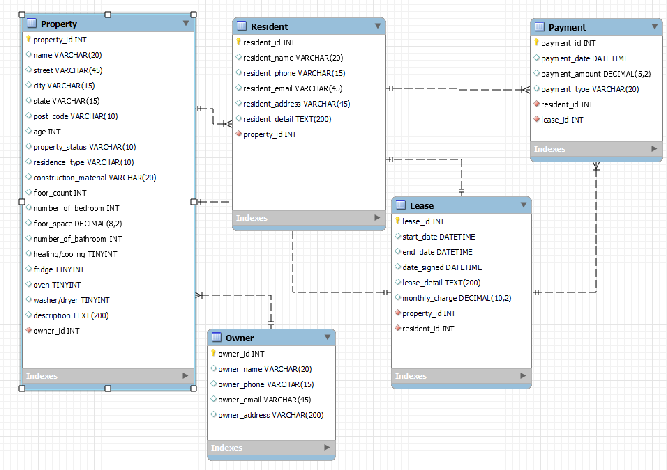
ER Diagram Design

